Slide 1


Chapter
7
Hypothesis Testing with One Sample

Slide 2
Chapter Outline
7.1 Introduction to Hypothesis Testing
7.2 Hypothesis Testing for the Mean (σ Known)
7.3 Hypothesis Testing for the Mean (σ Unknown)
7.4 Hypothesis Testing for Proportions
7.5 Hypothesis Testing for Variance and Standard
Deviation
.

Slide 3
Section 7.3
Hypothesis Testing for the Mean
(σ Unknown)
.

Slide 4
Section 7.3 Objectives
Find critical values in a t-distribution
Use the t-test to test a mean μ when σ is not known
Use technology to find P-values and use them with a t-test to test a mean μ
.

Slide 5
Finding Critical Values in a t-Distribution
Identify the level of significance α.
Identify the degrees of freedom d.f. = n – 1.
Find the critical value(s) using Table 5 in Appendix B in the row with n – 1 degrees of freedom. If the hypothesis test is
  left-tailed, use “One Tail, α ” column with a negative sign,
  right-tailed, use “One Tail, α ” column with a positive sign,
  two-tailed, use “Two Tails, α ” column with a negative and a positive sign.
.

Slide 6
Example: Finding Critical Values for t
Find the critical value t₀ for a left-tailed test given
α = 0.05 and n = 21.
Solution:
The degrees of freedom are d.f. = n – 1 = 21 – 1 = 20.
Use Table 5.
Look at α = 0.05 in the “One Tail, α” column.
Because the test is left-tailed, the critical value is negative.
0.05
-1.725
0
t
.

Slide 7
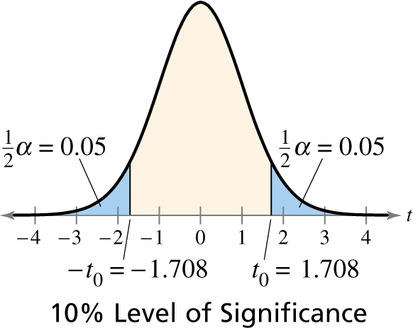
Example: Finding Critical Values for t
Find the critical values -t₀ and t₀ for a two-tailed test given α = 0.10 and n = 26.
Solution:
The degrees of freedom are d.f. = n – 1 = 26 – 1 = 25.
Look at α = 0.10 in the “Two Tail, α” column.
Because the test is two-tailed, one critical value is negative and one is positive.
.

Slide 8

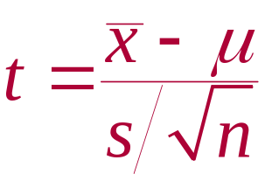
t-Test for a Mean μ (σ Unknown)
t-Test for a Mean
A statistical test for a population mean.
The t-test can be used when the population is normally distributed, or n ≥ 30.
The test statistic is the sample mean
The standardized test statistic is t.
The degrees of freedom are d.f. = n – 1.
.

Slide 9
Using P-values for a z-Test for Mean μ
(σ Unknown)
In Words In Symbols
Verify that σ is not known, the sample is random, and either the population is normally distributed or n ≥ 30.
State the claim mathematically and verbally. Identify the null and alternative hypotheses.
Specify the level of significance.
State H₀ and H_{a}.
Identify α.
.

Slide 10
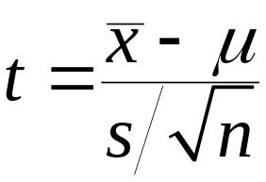
Using P-values for a z-Test for Mean μ
(σ Unknown)
In Words In Symbols
Identify the degrees of freedom.
Find the standardized test statistic.
Determine the rejection region(s).
Find the standardized test statistic and sketch the sampling distribution.
d.f. = n − 1
Use Table 4 in Appendix B.
.

Slide 11
Using P-values for a z-Test for Mean μ
(σ Unknown)
In Words In Symbols
Make a decision to reject or
fail to reject the null hypothesis.
Interpret the decision in the
context of the original claim.
If t is in the rejection region, reject H₀. Otherwise, fail to reject H₀.
.

Slide 12

Example: Testing μ with a Small Sample
A used car dealer says that the mean price of a two-year-old sedan is at least $20,500. You suspect this claim is incorrect and find that a random sample of 14 similar vehicles has a mean price of $19,850 and a standard deviation of $1084. Is there enough evidence to reject the dealer’s claim at α = 0.05? Assume the population is normally distributed. (Adapted from Kelley Blue Book)
.

Slide 13
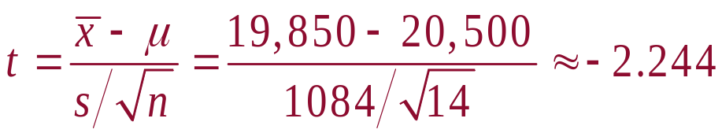
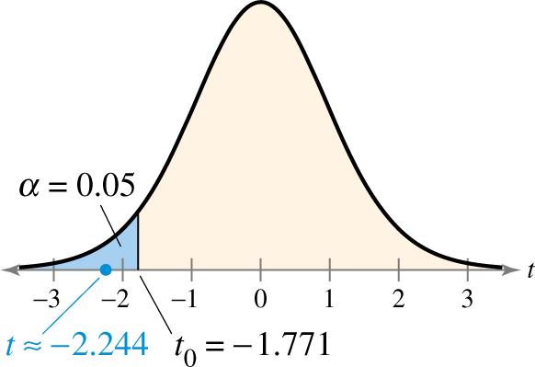
Solution: Testing μ with a Small Sample
Test Statistic:
Decision:
μ ≥ $20,500
H₀:
H_{a}:
α =
df =
Rejection Region:
μ < $20,500
0.05
14 – 1 = 13
Reject H₀
At the 0.05 level of significance, there is enough evidence to reject the claim that the mean price of a two-year-old sedan is at least $20,500.
.

Slide 14

Example: Hypothesis Testing
An industrial company claims that the mean pH level of the water in a nearby river is 6.8. You randomly select 39 water samples and measure the pH of each. The sample mean and standard deviation are 6.7 and 0.35, respectively. Is there enough evidence to reject the company’s claim at α = 0.05? Assume the population is normally distributed.
.

Slide 15
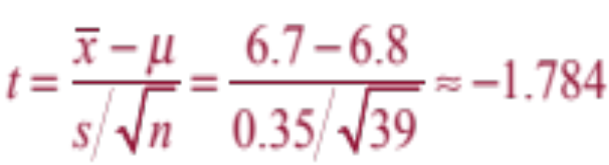
Solution: Testing μ with a Small Sample
μ = 6.8
H₀:
H_{a}:
α =
df =
Rejection Region:
Test Statistic:
Decision:
μ ≠ 6.8
0.05
39 – 1 = 38
Fail to reject H₀
At the 0.05 level of significance, there is not enough evidence to reject the claim that the mean pH is 6.8.
0.025
0.025
-2.024
2.024
t
-2.024
0
2.024
-1.784
.

Slide 16
Example: Using P-values with t-Tests
A department of motor vehicles office claims that the mean wait time is less than 14 minutes. A random sample of 10 people has a mean wait time of 13 minutes with a standard deviation of 3.5 minutes. At α = 0.10, test the office’s claim. Assume the population is normally distributed.
.

Slide 17
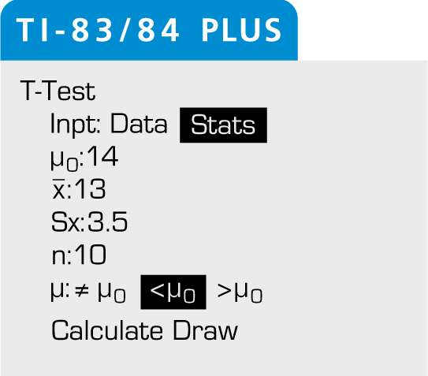
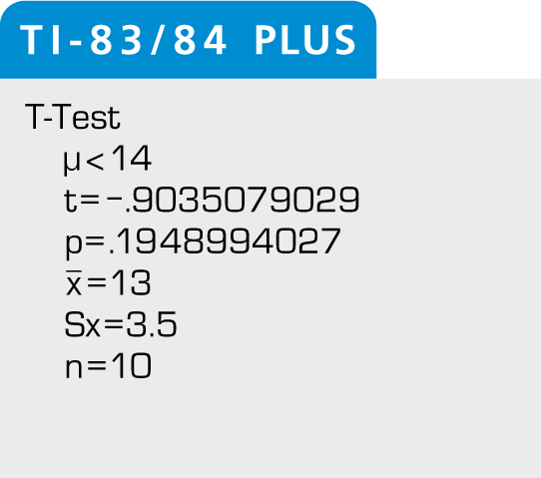
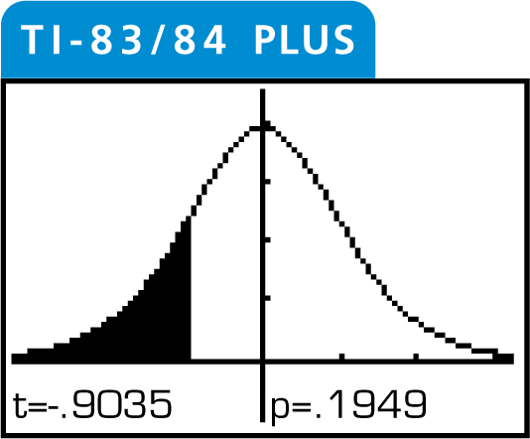
Solution: Using P-values with a t-Test
μ >= 14 min
H₀:
H_{a}:
μ < 14 min (Claim)
TI-83/84 setup:
Calculate:
Draw:
Decision:
0.1949 > 0.10
Fail to reject H₀. At the 0.10 level of significance, there is not enough evidence to support the office’s claim that the mean wait time is less than 14 minutes.
.

Slide 18
Section 7.3 Summary
Found critical values in a t-distribution
Used the t-test to test a mean μ when σ is not known
Used technology to find P-values and used them with a t-test to test a mean μ when σ is not known
.

